Slide 1
Heart Disease Diagnostic Analysis
Detailed Project Report
Taniya Nath
Data Science Intern | iNeuron
May 2022

Slide 2
Project Details
Project Title
Heart Disease Diagnostic – Analysis
Technology
Business Intelligence
Domain
Healthcare
Project Difficulty level
Advanced
Programming Language
Python
Tools
Jupyter Notebook, MS Excel, Tableau

Slide 3
Objectives
The goal of this project is to analyse the heart disease
occurrence, based on a combination of features that
describes the heart disease.

Slide 4
Problem Statement
Heart disease is a general term that means that the heart is not working normally. Health is real wealth in the pandemic time we all realized the brute effects of covid 19 on all irrespective of any status. You are required to analyse this health and medical data for better future preparation.
A dataset is formed by taking into consideration some of the information of 303 individuals.

Slide 5
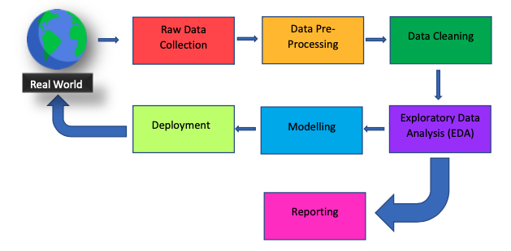
Architecture

Slide 6
Dataset Information
age: The person's age in years
sex: The person's sex (1 = male, 0 = female)
cp: The chest pain experienced (Value 1: typical angina, Value 2: atypical angina,
Value 3: non-anginal pain, Value 4: asymptomatic)
trestbps: The person's resting blood pressure (mm Hg on admission to the hospital)
chol: The person's cholesterol measurement in mg/dl
fbs: The person's fasting blood sugar (> 120 mg/dl, 1 = true; 0 = false)
restecg: Resting electrocardiographic measurement (0 = normal, 1 = having ST-T wave abnormality, 2 = showing probable or definite left ventricular hypertrophy by Estes' criteria)
thalach: The person's maximum heart rate achieved
exang: Exercise induced angina (1 = yes; 0 = no)
oldpeak: ST depression induced by exercise relative to rest
slope: the slope of the peak exercise ST segment (Value 1: upsloping, Value 2: flat, Value 3: down sloping)
ca: The number of major vessels (0-3)
thal: A blood disorder called thalassemia (3 = normal; 6 = fixed defect; 7 = reversable defect)
num: Heart disease (0 = no, 1 = yes)

Slide 7
Dataset Information (contd.)
Age: Age is the most important risk factor in developing cardiovascular or heart diseases, with approximately a tripling of risk with each decade of life. Coronary fatty streaks can begin to form in adolescence. It is estimated that 82 percent of people who die of coronary heart disease are 65 and older. Simultaneously, the risk of stroke doubles every decade after age 55.
Sex: Men are at greater risk of heart disease than pre-menopausal women. Once past menopause, it has been argued that a woman's risk is similar to a man’s although more recent data from the WHO and UN disputes this. If a female has diabetes, she is more likely to develop heart disease than a male with diabetes.
Resting Blood Pressure: Over time, high blood pressure can damage arteries that feed your heart. High blood pressure that occurs with other conditions, such as obesity, high cholesterol or diabetes, increases your risk even more.
Fasting Blood Sugar: Not producing enough of a hormone secreted by your pancreas (insulin) or not responding to insulin properly causes your body's blood sugar levels to rise, increasing your risk of heart attack.
Cholesterol: A high level of low-density lipoprotein (LDL) cholesterol (the "bad" cholesterol) is most likely to narrow arteries. A high level of triglycerides, a type of blood fat related to your diet, also ups your risk of heart attack. However, a high level of high-density lipoprotein (HDL) cholesterol (the "good" cholesterol) lowers your risk of heart attack.
Resting ECG: For people at low risk of cardiovascular disease, the USPSTF concludes with moderate certainty that the potential harms of screening with resting or exercise ECG equal or exceed the potential benefits. For people at intermediate to high risk, current evidence is insufficient to assess the balance of benefits and harms of screening.
Max heart rate achieved: The increase in the cardiovascular risk, associated with the acceleration of heart rate, was comparable to the increase in risk observed with high blood pressure. It has been shown that an increase in heart rate by 10 beats per minute was associated with an increase in the risk of cardiac death by at least 20%, and this increase in the risk is similar to the one observed with an increase in systolic blood pressure by 10 mm Hg.
ST Depression: In unstable coronary artery disease, ST-segment depression is associated with a 100% increase in the occurrence of three-vessel/left main disease and to an increased risk of subsequent cardiac events. In these patients an early invasive strategy substantially decreases death/myocardial infarction.

Slide 8
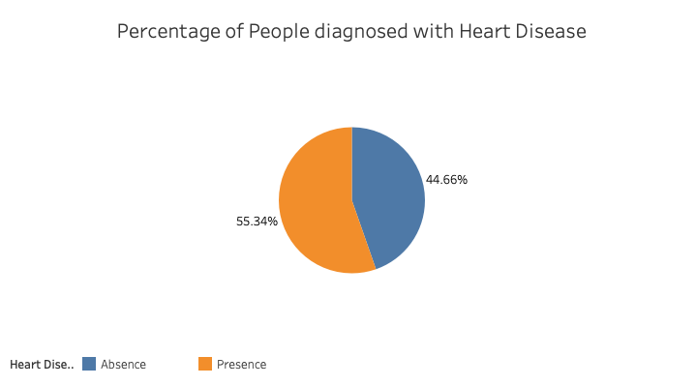
Data Analysis – Visualization and Insights
1. How much of the Population is affected from Heart Disease?
From this Pie-chart, we can see that 44.66% of the population is not diagnosed with heart disease whereas 55.34% has heart disease.

Slide 9
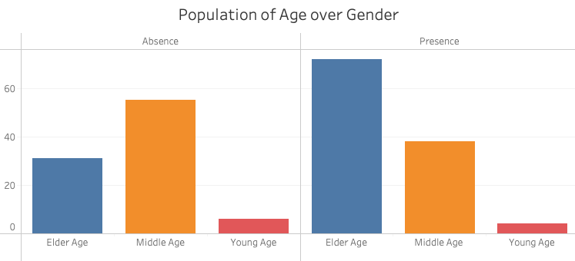
Data Analysis – Visualization and Insights
2. Who is suffering From Heart Disease?
According to this bar graph, Elderly and Middle aged people have more risk of heart diseases.

Slide 10
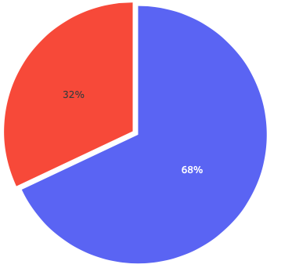
Data Analysis – Visualization and Insights
2. Who is suffering From Heart Disease? (contd…)
The following pie-chart shows that likelihood for heart disease in Males is 68% whereas for Females is 32%.

Slide 11
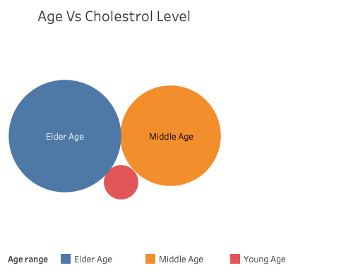
Data Analysis – Visualization and Insights
3. What Symptoms were experienced by people suffering from Heart Disease?
According to this bubble chart, Elderly aged people seems to have Higher Cholestrol Levels which increases their chances of Heart Disease.

Slide 12
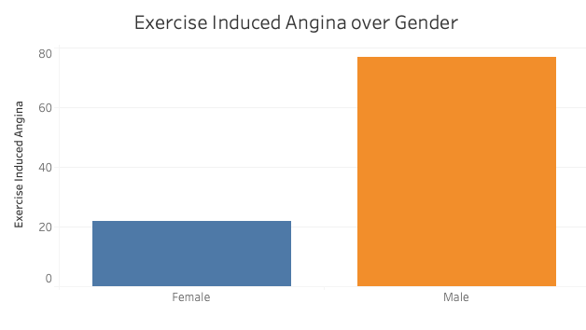
Data Analysis – Visualization and Insights
3. What Symptoms were experienced by people suffering from Heart Disease? (contd…)
The following bar graph shows that exercise induced Angina is prevalent more in Male.

Slide 13
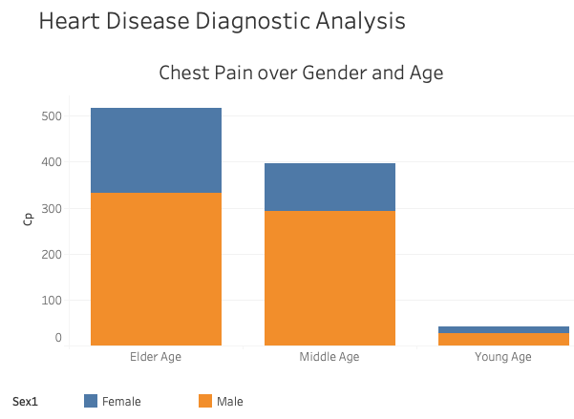
Data Analysis – Visualization and Insights
3. What Symptoms were experienced by people suffering from Heart Disease? (contd…)
In this bar graph, we can see that among the Male Elderly Aged people, Chest pain is high.

Slide 14
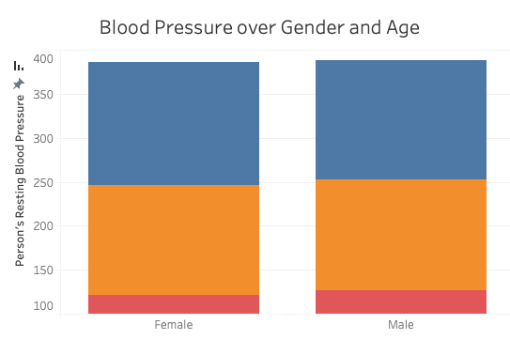
Data Analysis – Visualization and Insights
3. What Symptoms were experienced by people suffering from Heart Disease? (contd…)
And in this Bar, Blood pressure level for heart diseases is same in both Male and female.

Slide 15
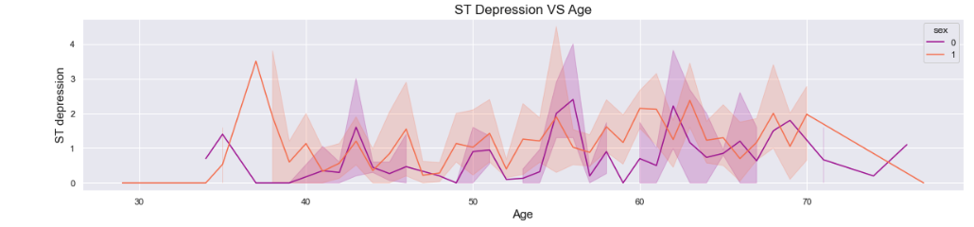
Data Analysis – Visualization in Python
ST depression induced by exercise relative to rest, a measure of abnormality in electrocardiograms. So here we can see ST depression is more in Male between age group of 50-60

Slide 16
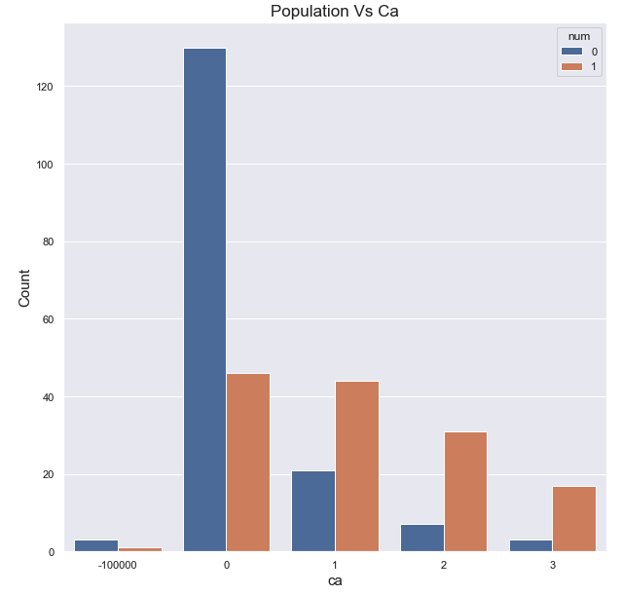
Data Analysis – Visualization in Python
Ca number of major vessels (0-3) colored by flourosopy ca has a positive corelation with the number i.e when Ca will decrease, we witness a drop in heart diseases and vice versa.

Slide 17
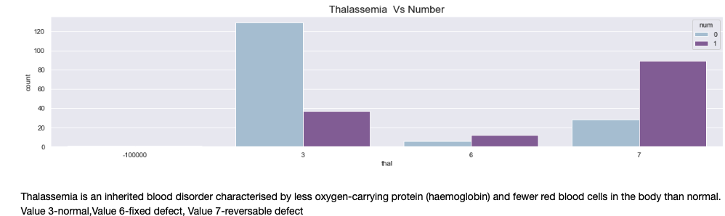
Data Analysis – Visualization in Python

Slide 18
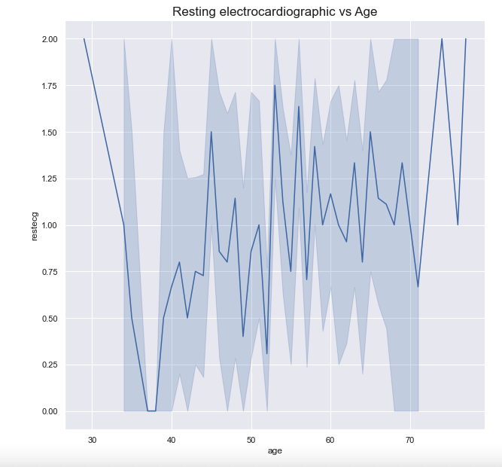
Data Analysis – Visualization in Python
Resting electrocardiographic results
(0-normal, 1-having ST-T, 2-hypertrophy)
Here we can clearly observe that Value 2 is more at the age of 75.

Slide 19
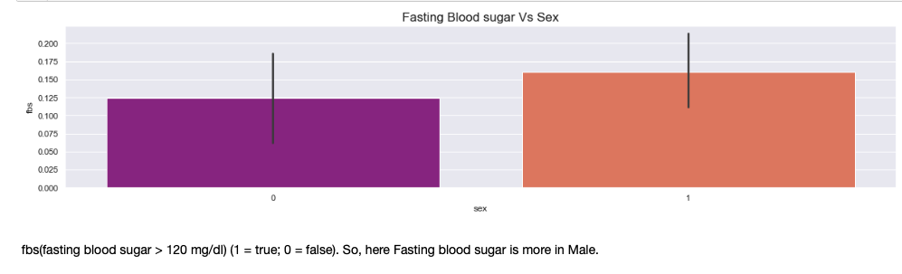
Data Analysis – Visualization in Python

Slide 20
Key Performance Indicators (KPI)
Percentage of People Having Heart Disease
Age Distribution including Gender
Gender Distribution Based on Heart Disease
Chest Pain Experienced by People Suffering from Heart Disease
Blood Pressure, Cholesterol Level and Maximum Heart Rate of
People According to their Age and Heart Disease Patients.
ST Depression Experienced by People According to their age and heart disease.

Slide 21
Conclusion
55.34% People suffering from heart disease.
Elderly Aged Men are more (50 to 60 Years) and Females are more in 55 to 65 Years Category
Males are more prone to heart disease.
Elderly Aged People are more prone to heart disease.
People having asymptomatic chest pain have a higher chance of heart disease.
High number of cholesterol level in people having heart disease.
Blood Pressure increases between age of 50 to 60 and somehow continue till 70.
Cholesterol and maximum heart rate Increasing in the age group of 50 60.
ST depression mostly increases between the age group of 30 40.

Slide 22
FAQ
Q1) What’s the source of data?
The Dataset was taken from iNeuron’s Provided Project Description Document. https://drive.google.com/drive/folders/165Pjmfb9W9PGy0rZjHEA22LW0Lt3Y-Q8
Q2) What was the type of data?
The data was the combination of numerical and Categorical values.
Q 3) What’s the complete flow you followed in this Project?
Please refer slide 5th for better Understanding
Q4) What techniques were you using for data?
Removing unwanted attributes
- Visualizing relation of independent variables with each other and output variables
- Cleaning data and imputing if null values are present.
Converting Numerical data into Categorical values.
Finding the Correlation among the attributes.
Q 6) What were the libraries that you used in Python?
I used Pandas, NumPy and Matplotlib and Seaborn libraries in Pandas.

